Slide 1
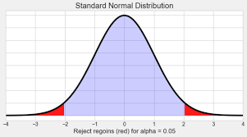
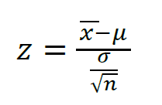
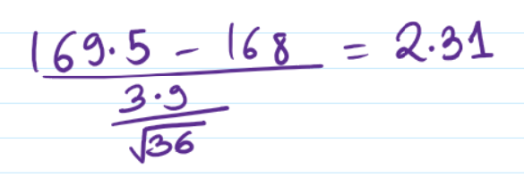
Mathematical Intuition of Z-Test
Question:-
The average height of all resident in a city is 168 cm with a population std 3.9. A doctor believe that the mean to be different . The measured height of 36 individual and found the average to tb 169.5 cm.
Null Hypothesis :- The average height of resident in a city is 168 cm.
Alternative Hypothesis :- The average height of resident in a city is not equal to 168 cm.
Population Mean = 168 cm
Population std. = 3.9
No. of samples = 36
Sample mean = 169.5 cm
Confidence Interval = 0.95
Level of Significance(Alpha) = 1 - 0.95 = 0.05
Decision Boundary = 1 – 0.025 = 0.9750 = +1.96
If Z-Test value fall b/w -1.96 to +1.96 we fail to reject the null hypothesis.
Conclusion:- If Z-Test is <-1.96 or >+1.96 Reject the Null Hypothesis.
Here we Reject the Null Hypothesis and Accept the Alternative Hypothesis.
The average height of resident in a city is not equal to 168 cm.

Slide 2
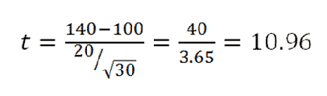
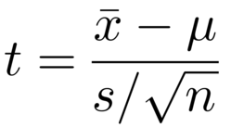
Mathematical Intuition of T-Test
Question:-
In Population the average IQ is 100. A team of Researchers want to test a new medication to see if it has either a positive or negative after on intelligence or no effect at all. A sample of 30 participants who have taken the medication has a mean of 140 with standard deviation of 20. Did the medication effect intelligence.
Null Hypothesis :- Medication not effect intelligence.
Alternative Hypothesis :-Medication effect intelligence.
Population Mean = 100
sample std. = 20
No. of samples = 30
Sample mean = 140
Confidence Interval = 0.95
Level of Significance(Alpha) = 1 - 0.95 = 0.05
Degree of freedom = n-1 = 29
Decision Boundary = 2.045
If Z-Test value fall b/w -2.045 to +2.045 we fail to reject the null hypothesis.
Conclusion:- If T-Test is <-2.045 or >+2.045 Reject the Null Hypothesis.
Here we Reject the Null Hypothesis and Accept the Alternative Hypothesis.
Medication effect intelligence.

